Slide 1

Information gathering tools
Domain name : https://www.thepresidiumschool.com/
Made by: Yukti Agarwal
Roll no.: 19csu366

Slide 2
Netcraft
Allows to understand what is running behind the website. For example:
IP address :103.76.212.58
Reverse DNS mp01.spectracloud.in
Domain thepresidiumschool.com
Nameserver mp01a.spectracloud.in
Domain registrar godaddy.com
Nameserver organisation whois.registry.in
Organisation unknown
DNS admin hg@spectracloud.com
Top Level Domain Commercial entities (.com)

Slide 3
Yougetsignal
Check if the website is dedicated or shared, tells the reverse IP domain
The main use is to know the location of the organization.
Network Location Tool, Visual Trace Route Tool, Phone Number Geolocator, Reverse E-mail Lookup Tool, etc are some tools

Slide 4
Whoislook
Tells who are we actually looking at like
Domain Information, Contact Information, Registrar Information, Authoritative Servers, etc
Registrar Information includes
Name: GoDaddy.com, LLC
IANA ID: 146
Abuse contact email: abuse@godaddy.com
Abuse contact phone: tel:480-624-2505

Slide 5
MXtoolbox
All of your MX record, DNS, blacklist and SMTP diagnostics in one integrated tool. Input a domain name or IP Address or Host Name. Links in the results will guide you to other relevant tools like
blacklist:Check IP or host for reputation
smtp:Test mail server SMTP (port 25)
mx:DNS MX records for domain
a : DNS A record IP address for host name
Spf, Txt, Ptr, Cname, Whois, Arin, Soa, Tcp, http, https, Ping, trace, dns

Slide 6
ip2location
Learn more about your Internet traffics, Identify Geographical Location and Proxy by IP Address
Geo IP solution to identify country, region, city, latitude & longitude, ZIP code, time zone, connection speed, ISP, domain name, IDD country code, area code, weather station data, mobile network codes (MNC), mobile country codes (MCC), mobile carrier, elevation, usage type and proxy.
Time Zone +05:30
Net Speed COMP
IDD & Area Code +(91) 0124
ZIP Code 122101

Slide 7
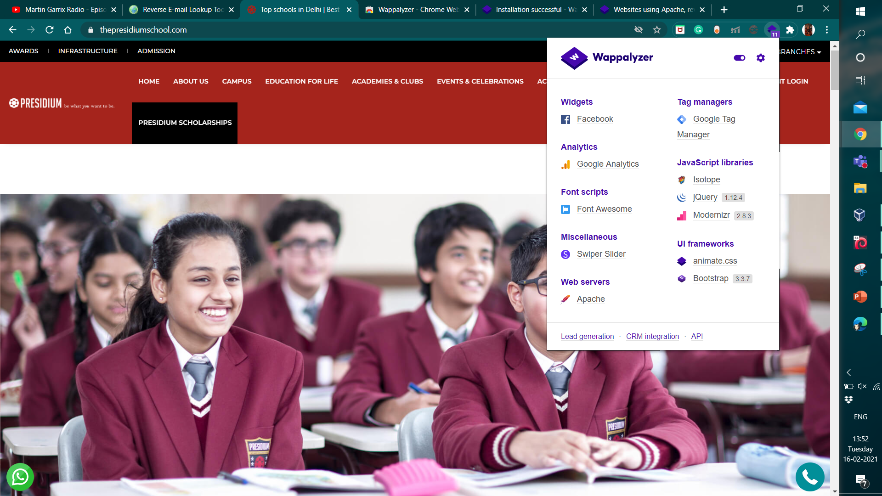
Wappalyzer
Wappalyzer gives information of the
javascript libraries,
UI frameworks, etc
used to make the websites

Slide 8
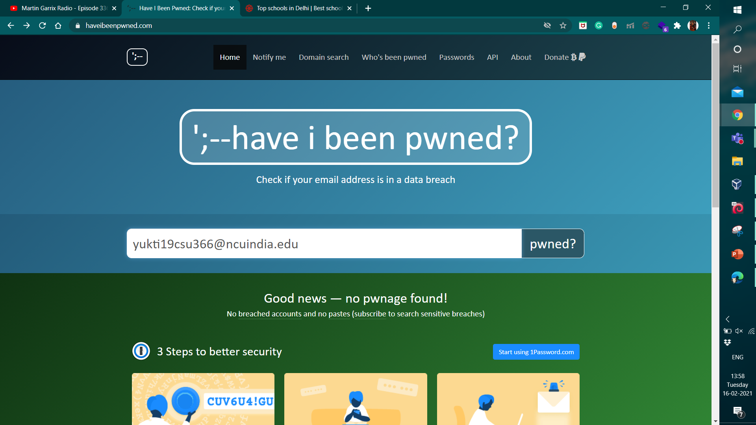
haveibeenpwned
Identity theft can cause you financial damage and legal problems. There are many ways your email can be pwned. In addition to being part of a breach, your email account can be hacked through malware attacks on any of your devices, or through phishing scams. You can check if your information has been a part of a breach.

Slide 9
pipl
Pipl's unique identity resolution engine connects the world's personal, professional and social identity data to give analysts and investigators.
Tools provided are Compliance Resources, General Data Protection Regulation (GDPR), Privacy Shield Notice, Information Security Standards, Data Collection Practices, Permissible.

Slide 10
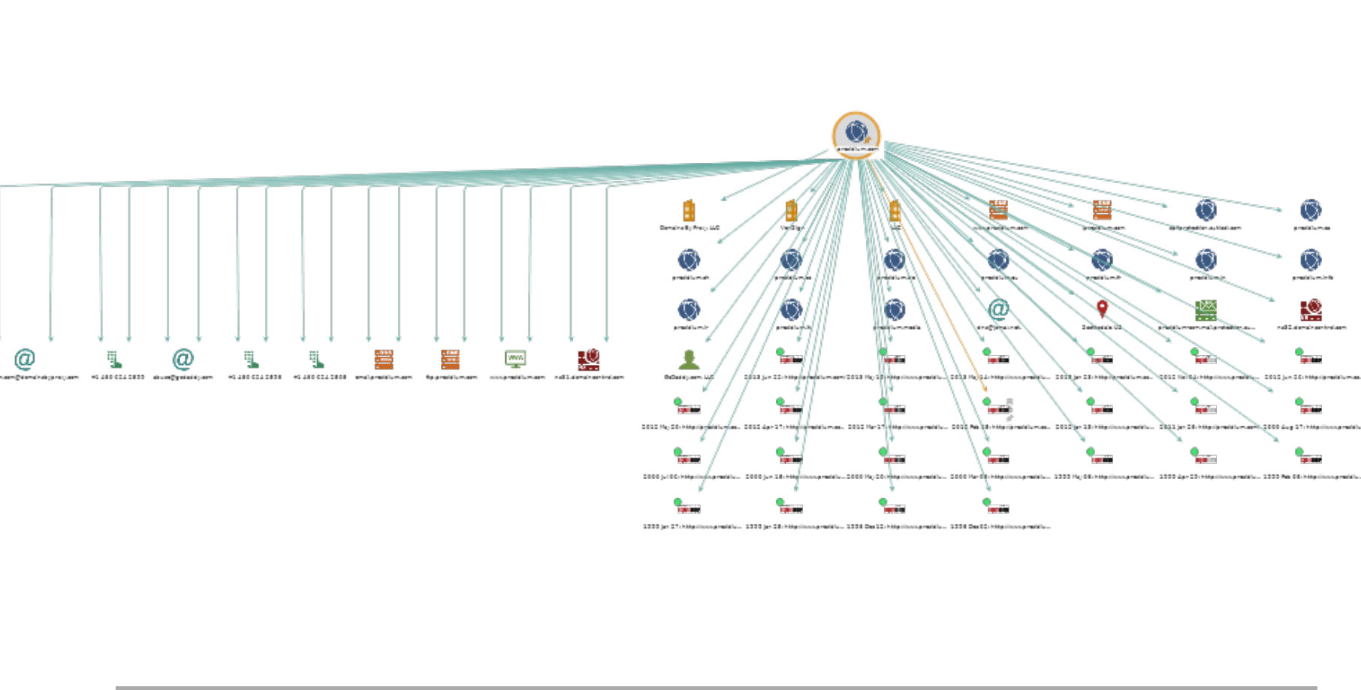
Maltego
This tool has many functions. For example:

Slide 11
Harvester
theharvester – A tool for gathering e-mail accounts and subdomain names from public sources
theHarvester -d presidium.com -l 100 -b google is one of the command that can be used.
-d: Domain to search or company name -b: data source: baidu, bing, bingapi, dogpile, google, googleCSE, googleplus, google-profiles, linkedin, pgp, twitter, vhost,virustotal, threatcrowd, crtsh, netcraft, yahoo, all -s: start in result number X (default: 0) -v: verify host name via dns resolution and search for virtual hosts -f: save the results into an HTML and XML file (both) -n: perform a DNS reverse query on all ranges discovered -c: perform a DNS brute force for the domain name -t: perform a DNS TLD expansion discovery -e: use this DNS server -p: port scan the detected hosts and check for Takeovers (80,443,22,21,8080) -l: limit the number of results to work with(bing goes from 50 to 50 results, google 100 to 100, and pgp doesn't use this option) -h: use SHODAN database to query discovered hosts

Slide 12
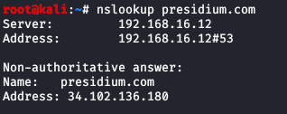
nslookup
nslookup is a network administration command-line tool for querying the Domain Name System to obtain domain name or IP address mapping, or other DNS records.
It can help in finding the mail exchanger, name servers or soa(state of authority)

Slide 13
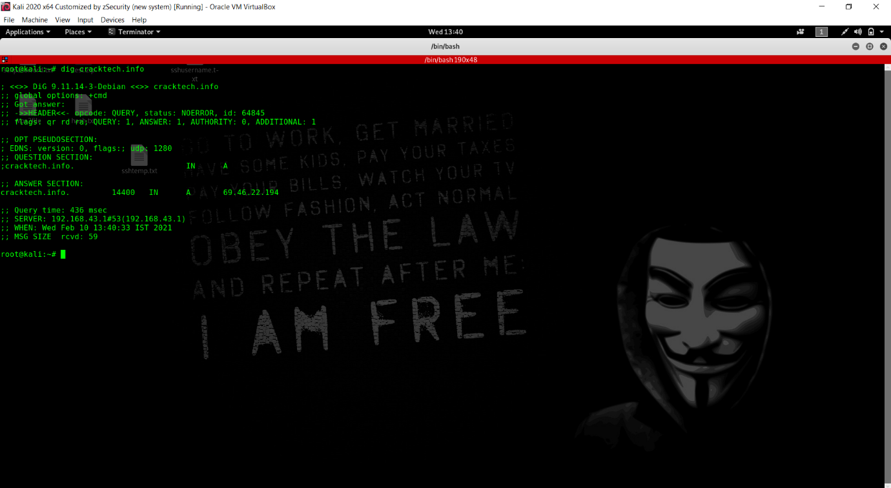
dig
Introduction
The dig command in Linux is used to gather DNS information. It stands for Domain Information Groper, and it collects data about Domain Name Servers. The dig command is helpful for diagnosing DNS problems, but is also used to display DNS information.
Dig syntax:
dig [server] [name] [type]
[server] – The hostname or IP address the query is directed to
[name] – The DNS (Domain Name Server) of the server to query
[type] – The type of DNS record to retrieve. By default (or if left blank),

Slide 14
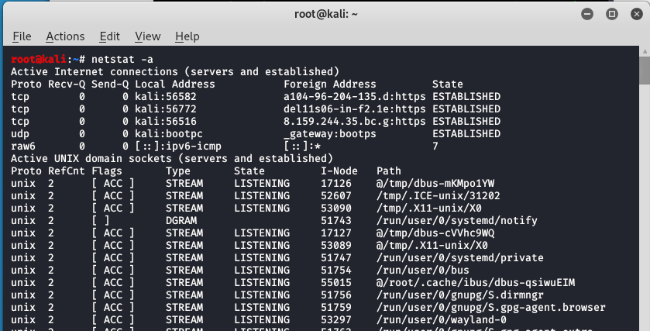
Netstat
Netstat is a command line utility that can be used
to list out all the network (socket) connections on a
system. It lists out all the tcp, udp socket connections
and the unix socket connections.
Apart from connected sockets it can also list listening
sockets that are waiting for incoming connections.
Listing all the LISTENING Ports of TCP and UDP connections
(netstat -a ), TCP Ports connections(netstat -at),
UDP Ports connections(netstat -au), etc.

Slide 15
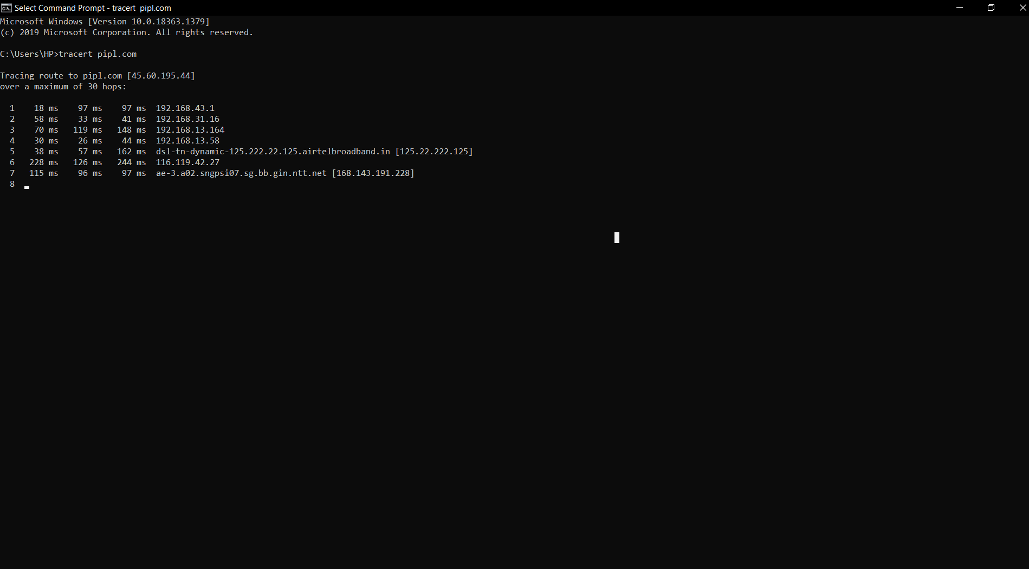
Trace route
traceroute command in Linux prints the route that a packet takes to reach the host. This command is useful when you want to know about the route and about all the hops that a packet takes.
Syntax of traceroute:
traceroute [options] host_Address [pathlength]
Example : traceroute -4 google.com

Slide 16
Tools | About
Netcraft | Allows to understand what is running behind the website
Yougetsignal | Network Location Tool, Visual Trace Route Tool, Phone Number Geolocator, Reverse E-mail Lookup Tool,
Whoislook | Domain Information, Contact Information, Registrar Information, Authoritative Servers
MXtoolbox | Spf, Txt, Ptr, Cname, Whois, Arin, Soa, Tcp, http, https, Ping, trace, dns
ip2location | Learn more about your Internet traffics, Identify Geographical Location and Proxy by IP Address
Wappalyzer | information of the javascript libraries, UI frameworks, etc used to make the websites
haveibeenpwned | Identity theft can cause you financial damage and legal problems.
pipl | Compliance Resources, General Data Protection Regulation (GDPR), Privacy Shield Notice, Information Security Standards

Slide 17
Tools | About
Maltego | Maltego focuses open source intelligence (OSINT)
Harvester | -d website -l 100 -b google
nslookup | Syntax : nslookup website name Helps to send queries
dig | dig [server] [name] [type] [server] – The hostname or IP address the query is directed to [name] – The DNS (Domain Name Server) of the server to query [type] – The type of DNS record to retrieve. By default (or if left blank
Netstat | netstat –at, netstat –a, netstat –au, etc
Trace route | traceroute [options] host_Address [pathlength] Example : traceroute -4 google.com

